Slide 1
Statements
Abylkassymova A. B.

Slide 2
Types
If Statement
While Statement
For Statement
List Comprehensions
Error handling:
Try Statement
With Statement
Other Statements

Slide 3
Conditional Statements

Slide 4
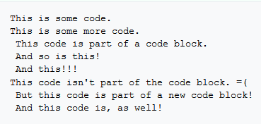
If Statements
Unlike many other computer languages, like C++ and java, Python uses indentation to determine blocks of code. The following pseudocode below will help demonstrate.
There can be multiple blocks of code. You can also contain blocks of code within another block of code, so long as it indents.
NO LIMIT on the indent, but it must be kept constant or you'll get an error.

Slide 5
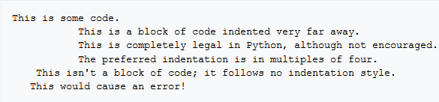

BUT….
Tabs OR white spaces – up to YOU;
DO NOT mix – will cause an error;
It is preferred that you use white spaces!

Slide 6
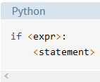

Simplest form of IF Statement
<expr> is an expression evaluated
in Boolean context, as discussed in
the lecture about Logical Operators.
<statement> is a valid Python
statement, which must be indented.
Is required!

Slide 7
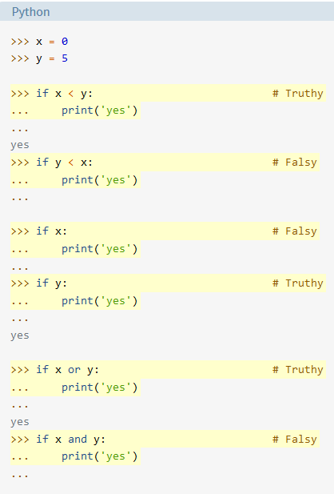
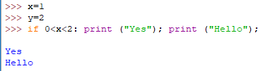
Examples
In-line coding

Slide 8
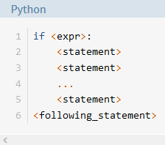
Another cases
In all the examples shown above, each if <expr>: has been followed by only a single <statement>.
There needs to be some way to say “If <expr> is true, do all of the following things.”

Slide 9
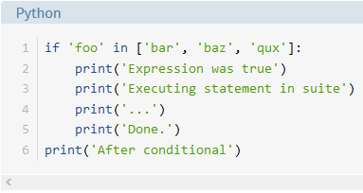
Let’s play ☺
What will be printed on the output?

Slide 10
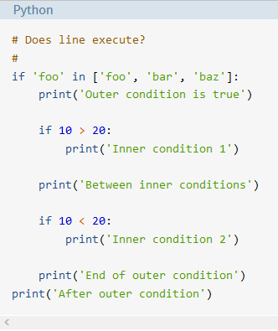
What about this one?

Slide 11
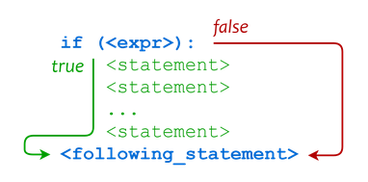
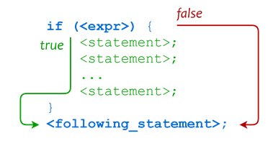
Comparison
Python
C++

Slide 12
Which Is Better?
On the plus side:
Python’s use of indentation is clean, concise, and consistent.
In programming languages that do not use the off-side rule, indentation of code is completely independent of block definition and code function. It’s possible to write code that is indented in a manner that does not actually match how the code executes, thus creating a mistaken impression when a person just glances at it. This sort of mistake is virtually impossible to make in Python.
Use of indentation to define blocks forces you to maintain code formatting standards you probably should be using anyway.
On the negative side:
Many programmers don’t like to be forced to do things a certain way. They tend to have strong opinions about what looks good and what doesn’t, and they don’t like to be shoehorned into a specific choice.
Some editors insert a mix of space and tab characters to the left of indented lines, which makes it difficult for the Python interpreter to determine indentation levels. On the other hand, it is frequently possible to configure editors not to do this. It generally isn’t considered desirable to have a mix of tabs and spaces in source code anyhow, no matter the language.

Slide 13


Common Mistakes
The operator for equality consists of two equals signs. It is a really common error to forget one of the equals signs.
A common mistake is to use and where or is needed or vice-versa. Consider the following if statements:

Slide 14
Common Mistakes
Another very common mistake is to write something like below:
if grade>=80 and <90:
This will lead to a syntax error.
if grade>=80 and grade<90:
On the other hand, there is a nice shortcut that does work in Python:
if 80<=grade<90:

Slide 15
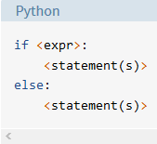
The else and elif Clauses
If <expr> is true, the first suite is executed, and the second is skipped.
If <expr> is false, the first suite is skipped and the second is executed.

Slide 16
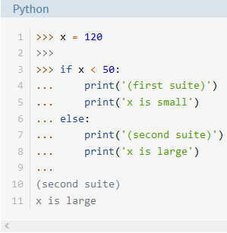
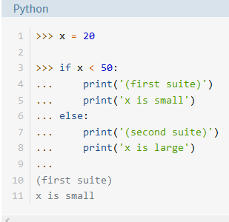
Examples

Slide 17
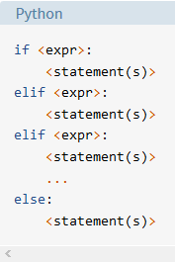
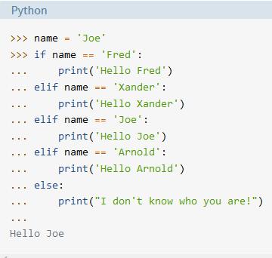
Branching Execution
Could be done in more intelligent way ;)

Slide 18
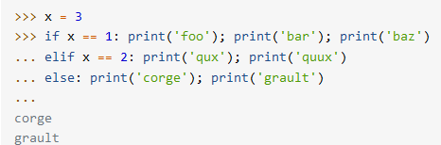
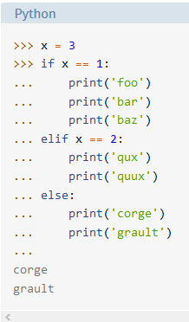
In-line vs Block Example
See the difference …?

Slide 19

Conditional Expressions
The simplest form:
This is different from the if statement forms listed above because it is not a control structure that directs the flow of program execution.
It acts more like an operator that defines an expression.
In the above example, <conditional_expr> is evaluated first.
If it is true, the expression evaluates to <expr1>. If it is false, the expression evaluates to <expr2>.
In C++
<conditional_expr> ? <expr1> : <expr2>

Slide 20
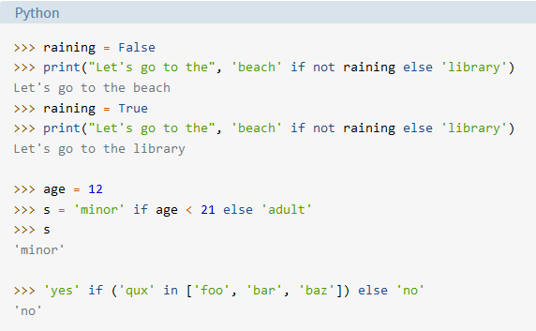
Example

Slide 21
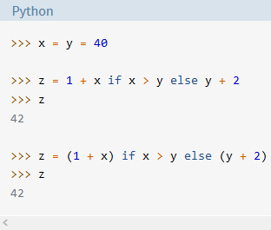
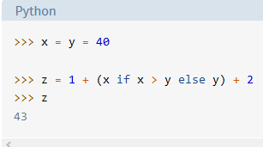
More about Conditional Expressions
behaves like an expression syntactically;
can be used as part of a longer expression;
has lower precedence than virtually all the other operators;
parentheses are needed to group it by itself;
VS

Slide 22
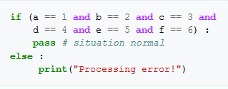
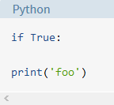
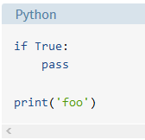
The pass Statement
It doesn’t change program behavior at all;
It is used as a placeholder to keep the interpreter happy in any situation where a statement is syntactically required, but you don’t really want to do anything;
Will cause an error

Slide 23
While Statement

Slide 24
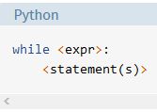
Overview
This statement will execute its code block over and over again until its conditions are false.
This can be useful if something needs to be repeated over and over for a said amount of time.
The format of a rudimentary while loop is:

Slide 25
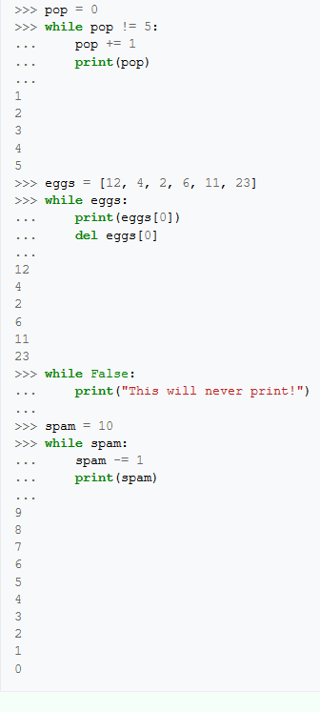
Examples

Slide 26
Notes
A while statement's condition is always true or false, like the if statement.
This means Boolean math can be used to control the looping.
Since while
False: will never execute;
What will while True: DO?

Slide 27

While + Else ?
Unlike a lot of other computer languages, Python allows you to use an else statement in conjunction with a while statement.
When a while statement finishes its loop naturally, it will then execute the else statement.
If the while statement stops prematurely for any reason, it will not execute the else statement. An example is given below.

Slide 28
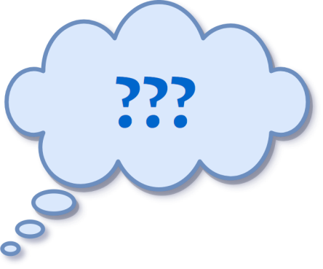
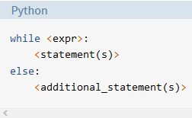
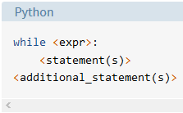
This is a format:
BUT according to the slide above, it could be:

Slide 29
What’s the difference?
Without the else clause, <additional_statement(s)> will be executed after the while loop terminates, no matter what.
When <additional_statement(s)> are placed in an else clause, they will be executed only if the loop terminates “by exhaustion”—that is, if the loop iterates until the controlling condition becomes false. If the loop is exited by a break statement, the else clause won’t be executed.

Slide 30
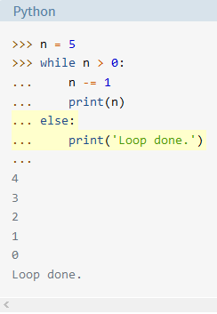
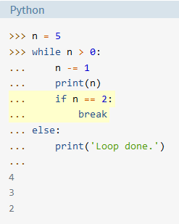
Example

Slide 31
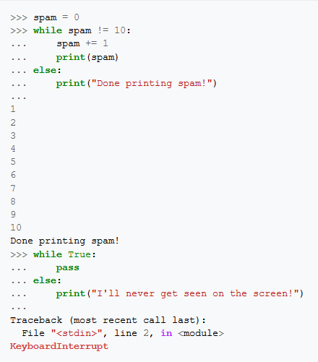
Examples

Slide 32
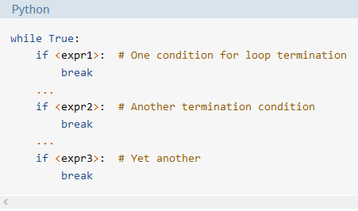
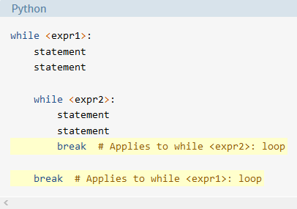
Break
To prematurely end a while statement;
Can be used to prematurely end the while statement that it's nested in. This means it will end only one while statement, not all of them.

Slide 33
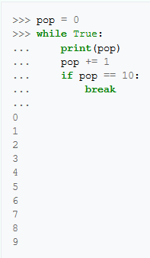
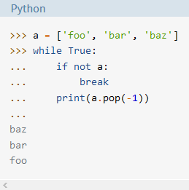
Examples

Slide 34
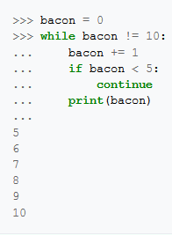
Continue
Will stop the current execution of code and go back to the beginning of the while statement;
To skip part of the code and not end the loop at the same time.
The same format as for a
Break statements;

Slide 35
For loops

Slide 36

Overview
Probably the most powerful thing about computers is that they can repeat things over and over very quickly;
There are several ways to repeat things in Python, the most common of which is the for loop;
For loop - Good for iterator-based;

Slide 37

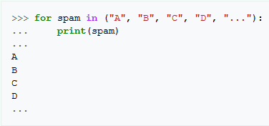
Format
must be in lowercase
Indentation is required!
required

Slide 38
For loop Python vs For Loop C++
differs significantly!
Since Python's for statement is iterator-based, how would we have the temporary variable hold a number that increments on every loop?
DESICION could be a LARGE TUPLE;
But this would waste a lot of memory and time!
The built-in function range() can help us here!

Slide 39
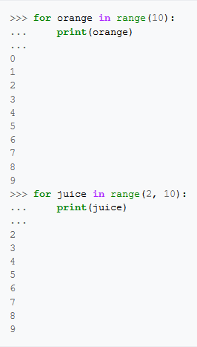
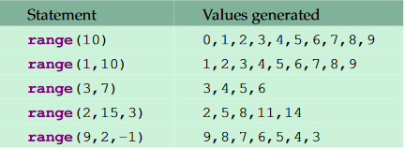

The range function
?

Slide 40
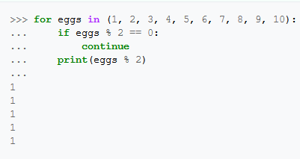
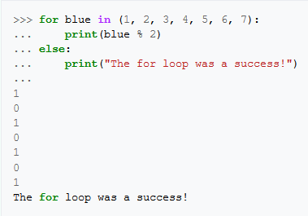
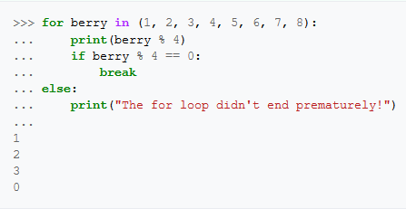
Else, Break, Continue Statements
Similar to while statements;

Slide 41
List Comprehensions

Slide 42


Introduction
List comprehensions provide a concise way to create lists.
Common applications are to make new lists where each element is the result of some operations applied to each member of another sequence or iterable, or to create a subsequence of those elements that satisfy a certain condition.

Slide 43
Error handling

Slide 44

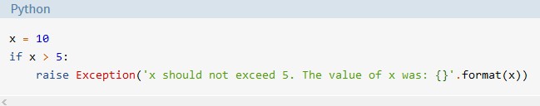
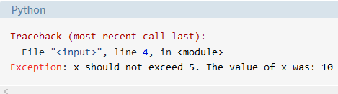
Raising an Exception
To throw an exception if a condition occurs.
Example:

Slide 45
Type of Errors
Syntax errors - caused by not following the proper structure;
Assert (raise-if/raise-if not)- is a sanity-check that you can turn on or turn off when you are done with your testing of the program;
Exceptions - a statement or expression is syntactically correct, it may cause an error when an attempt is made to execute it;
Built-in exceptions User-defined exceptions

Slide 46

Assert (internal self-checks )
Usual place of assertions at the start of a function to check for valid input, and after a function call to check for valid output.
Syntaxes:
If the assertion fails, Python uses ArgumentExpression as the argument for the AssertionError.
AssertionError exceptions can be caught and handled like any other exception using the try-except statement, but if not handled, they will terminate the program and produce a traceback

Slide 47
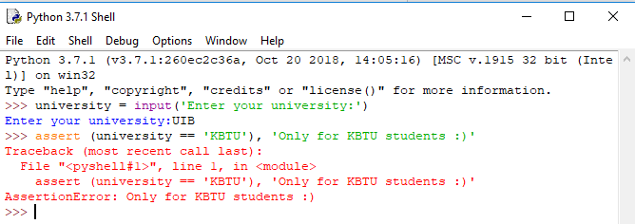

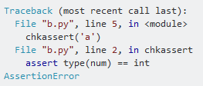
Example of assert

Slide 48
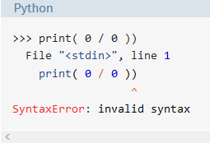
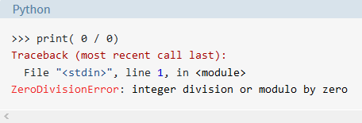
Example (Syntax vs Exception)
After removing extra bracket

Slide 49
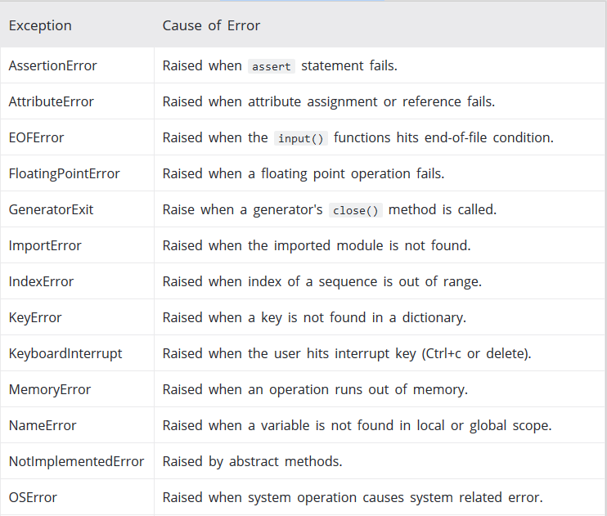
P y t h o n B u I l t- I n E x c e p t I o n s

Slide 50
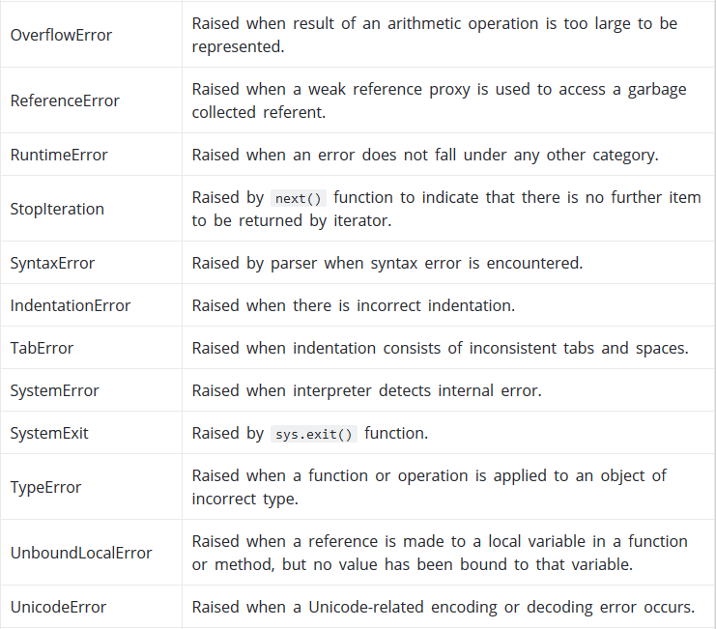
P y t h o n B u I l t- I n E x c e p t I o n s

Slide 51

P y t h o n B u I l t- I n E x c e p t I o n s

Slide 52

Example of built-in exceptions
What if there is an specific exception of your own program?

Slide 53

User-defined Exceptions
Handling Exceptions - If you are writing a program that someone else is going to use, you don’t want it to crash if an error occurs!
Example:
The program will crash
There is a way to avoid a crush!!!

Slide 54

Syntaxes
When an error occurs, an exception is generated. You can catch this exception and allow your program to recover from the error without crashing.

Slide 55

Example
DIFERRENCES:
The program was executed.
Exception did not crush the program.
The message “Hi there” was printed

Slide 56



Different possibilities
Multiple statements in the try block and also and multiple except blocks, like below:
If you do not know the name of Exception:
Give your own name:
NOT RECOMMENDED

Slide 57

Try/except/else

Slide 58


Example

Slide 59

Try/except/else/finally

Slide 60


Example
must be executed under all circumstances

Slide 61


With ….. as
Allows objects like files to be used in a way that ensures they are always cleaned up promptly and correctly;
Syntaxes:
Example:

Slide 62
Conclusion
raise allows you to throw an exception at any time.
assert enables you to verify if a certain condition is met and throw an exception if it isn’t.
In the try clause, all statements are executed until an exception is encountered.
except is used to catch and handle the exception(s) that are encountered in the try clause.
else lets you code sections that should run only when no exceptions are encountered in the try clause.
finally enables you to execute sections of code that should always run, with or without any previously encountered exceptions.

